Slide 1
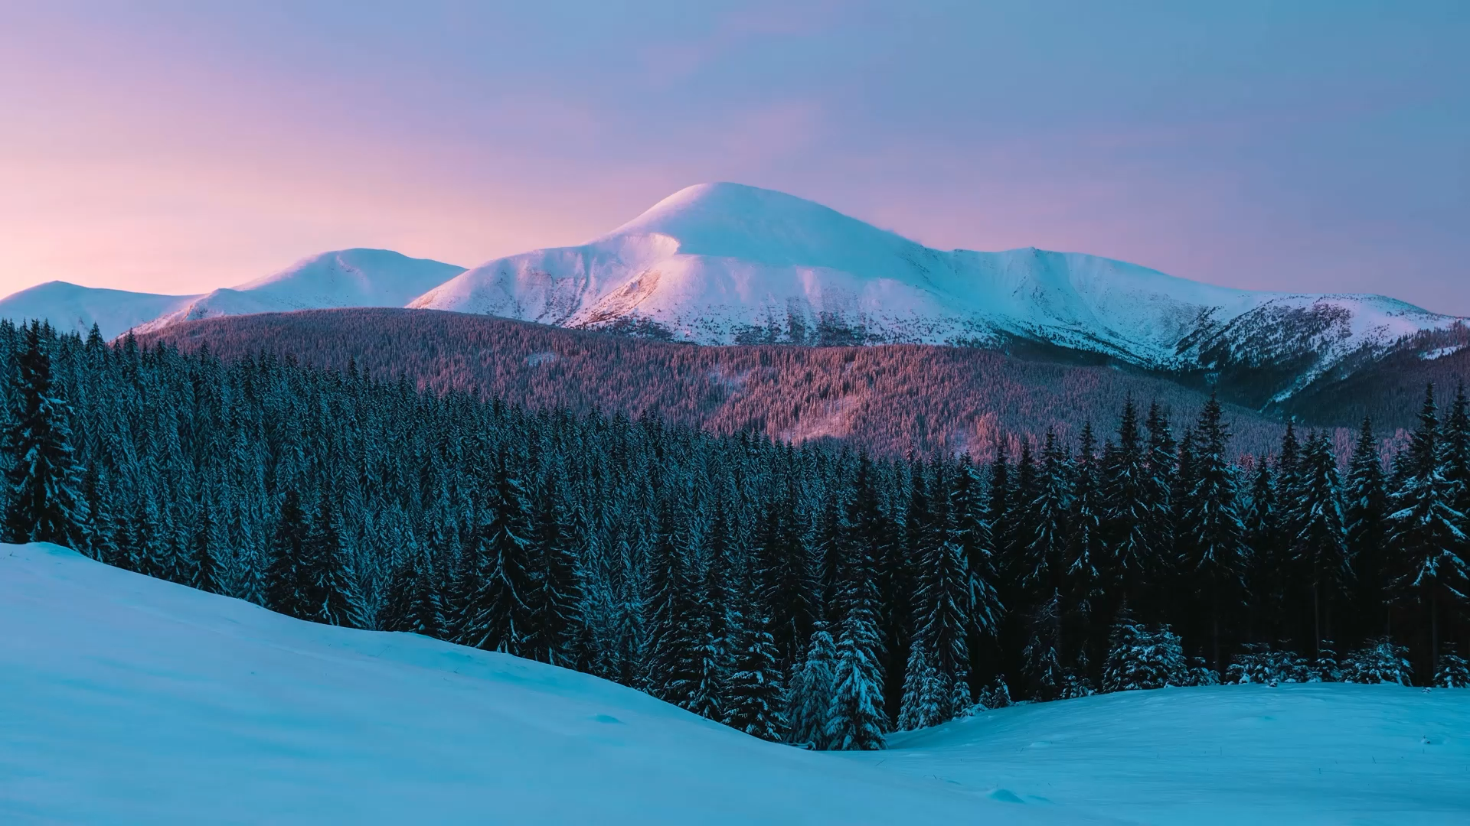
Big Mountain Ski Resort
Recommendation Summary

Slide 2
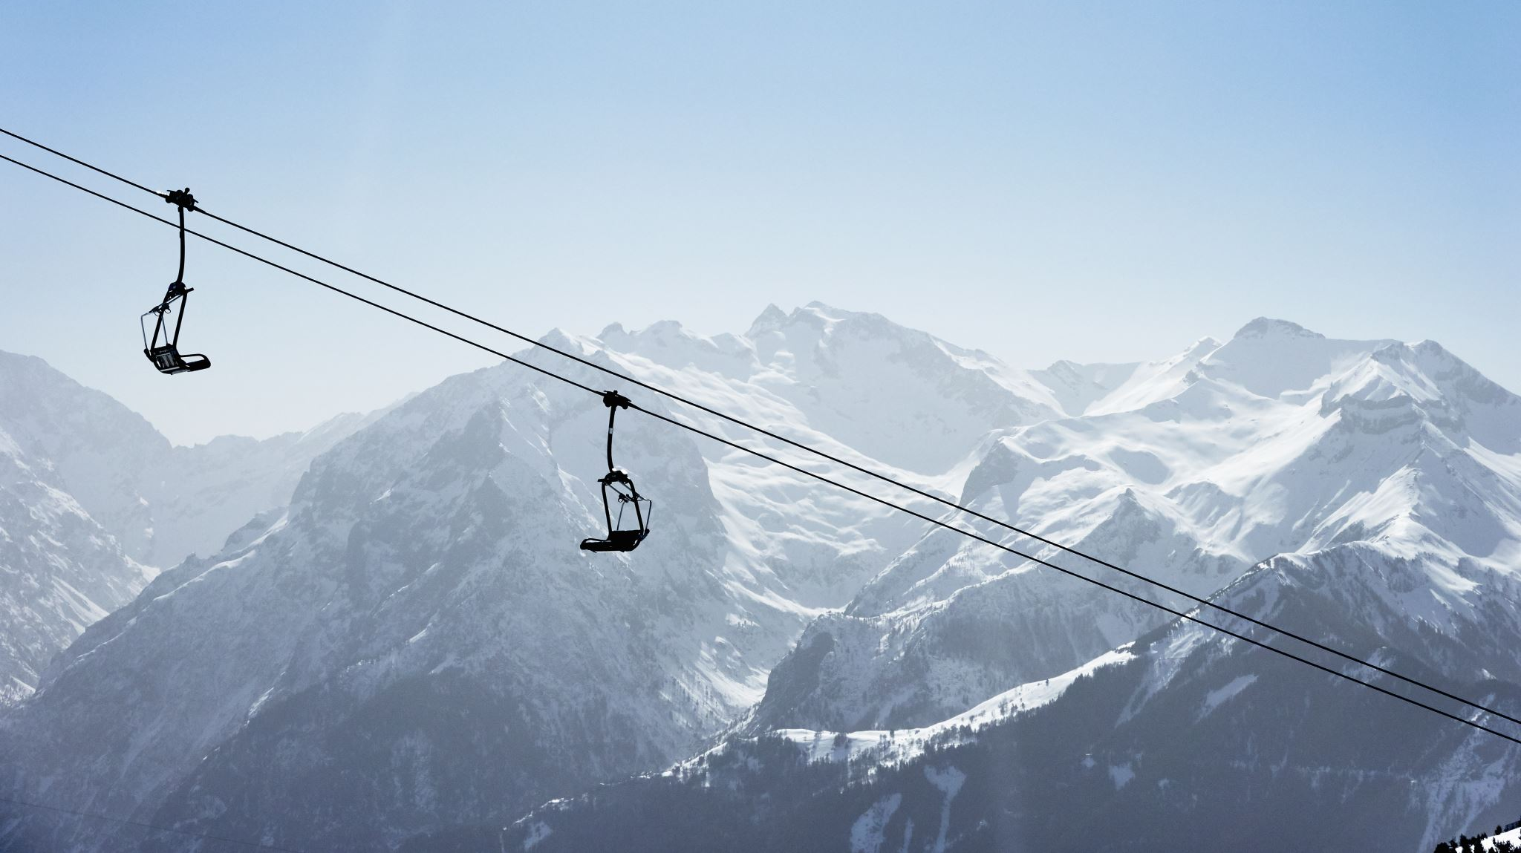
What’s the best way to cover the cost of Big Mountain’s new $1.54M ski lift and maximize profits?

Slide 3
Recommendations
1. Increase lift ticket price by $4.00 this season
2. Increase vertical drop by adding another chair lift next season

Slide 4
Key findings based on modeling
Comparing Big Mountain’s robust facilities to other top resorts nationally, fair market ticket price is $95.87. Considering absolute error, we recommend $85.00 ticket price.
Adding another chair lift to increase vertical drop by 150 feet increases the projected ticket price by an additional $1.99.

Slide 5
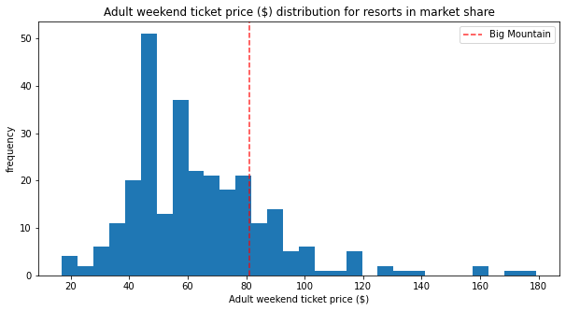
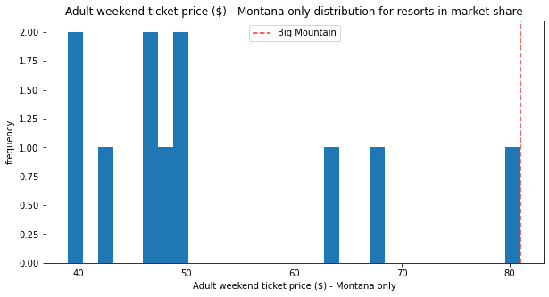
Ticket Prices – National vs Montana
Even though Big Mountain’s ticket price is the highest price for Montana, there’s plenty of room for a price increase when comparing top resorts throughout the country.

Slide 6
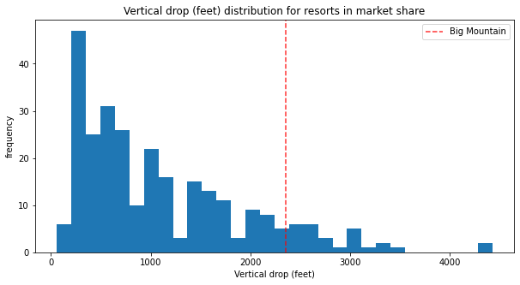
Increasing Vertical Drop
To compete with other top resorts nationally, Big Mountain may want to add another chair lift and increase vertical drop.

Slide 7
Show me the money!
Increasing ticket prices this season by $4 will generate an additional $7M this season. (350K people purchasing on average 5 tickets each) This more than covers the cost of the new lift and can pay for the purchase of another lift next season
Our model predicts that adding another chair lift next season to increase vertical drop will increase the ticket price by an additional $1.99 generating another $3.5M

